Slide 1
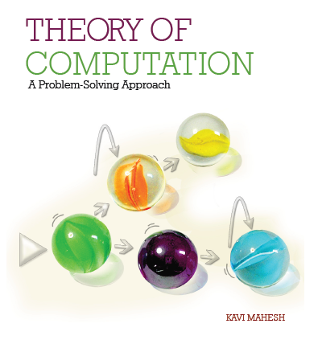

Theory of Computation: A Problem-Solving Approach
Chapter – 7: Context-Free Languages and Grammars

Slide 2
Learning Objectives
Learn what context-free behavior is.
Learn how context-free grammars can derive languages that are not regular.
Learn to construct linear context-free grammars.
Learn to construct non-linear context-free grammars.
Learn to construct leftmost and rightmost derivation trees for strings.
Learn the relationship between parsing and ambiguity in grammars.
Learn to eliminate ambiguity in grammars.
Learn to convert a context-free grammar to Chomsky Normal Form.
Learn to convert a context-free grammar to Greibach Normal Form.
Learn to parse a string using the CYK algorithm.

Slide 3
The Idea of Context-Free Behavior
In linguistics, context refers to the relevant constraints of the communicative situation, both verbal and social, that influence language use, language variation and discourse.
For us, context usually means the surrounding text, that is, what appears before and what appears after the current (set of) symbol(s) in the input string.
Context-free means being able to take an action irrespective of the context, that is, irrespective of the surroundings.
A grammar is called context-free (CFG) if the application of a production rule for parsing or derivation is independent of the context in the sentential form where it is applied.
If a variable A occurs in the sentential form, it can be expanded using any production whose left-hand side is A irrespective of what terminal or variable is to the left or right of A in the present sentential form (and, indirectly, in the input string).
Every production rule must have only one non-terminal (and nothing else) on its left-hand side.

Slide 4
Non-Context-Free Grammars
If a variable can only be expanded in a given context
If the context is encoded on the left-hand side of the production rule
E.g., aS → aaSb can be applied only if the S is preceded by an a
Such grammars are called context-sensitive grammars (see Chapter 11)

Slide 5
Context-Free Grammars
Every regular grammar is context-free, but
Not every context-free grammar is regular
It may not be right-linear or left-linear, i.e., it may have a variable in the middle of the right-hand side of the grammar, surrounded by terminal symbols on both sides
E.g., S → aSb | λ
It may not even be linear, i.e., may have more than one variable on the right-hand side

Slide 6
CFG: Example 7.1
Even number of a s followed by even number of b s: (aa)*(bb)*
S → aaS | Sbb | aaSbb | λ
This is a CFG but is not regular
An equivalent right-linear grammar (since this is a regular language) is:
S → aaS | T
T → bbT | λ

Slide 7
Context-Free Languages
What is the language of a CFG that is not regular?
The language of a grammar is the set of all strings over its alphabet which can be derived or generated from the start symbol S of the grammar, or,
The same set of grammatically correct strings which can be parsed using the grammar to construct a parse tree with S as its root and the input string along the leaves of the parse tree (which is also called the yield of the parse tree).
The language of a CFG that is not a regular language is called a context-free language (CFL for short).
CFLs are a superset of the set of regular languages, that is, there are CFLs that are not regular as we saw in Chapter 6.
One cannot construct a finite automaton or regular expression for a CFL that is not regular.

Slide 8
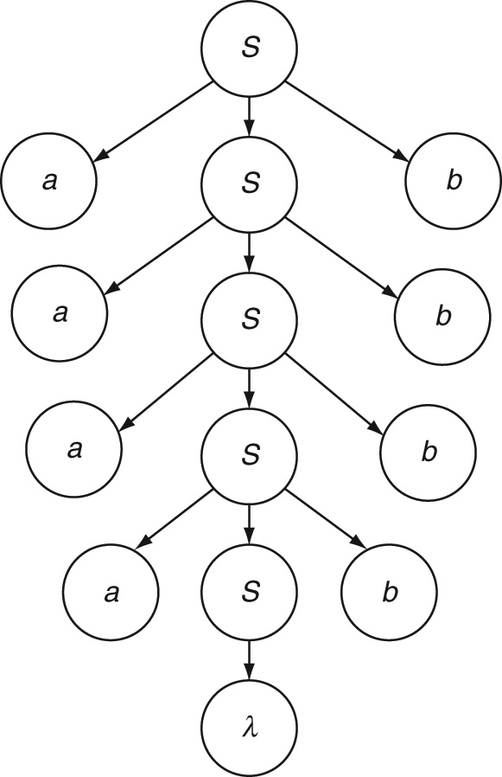
Linear CFG: Example 7.2
Simple nesting language a^{n}b^{n}
Observation: a^{n}b^{n} = aa^{n-1}b^{n-1}b
S → aSb | λ
Derivation for a⁴b⁴
Parse tree:

Slide 9

Linear CFG: Example 7.3
Even palindromes ww^{R}
S → aSa | bSb | λ
Derivation of: abbabbabba

Slide 10
Linear CFG: Examples 7.4, 7.5, 7.6, 7.7
Example 7.4: Odd palindromes wcw^{R}
S → aSa | bSb | c
Example 7.5: One more b than a, i.e., a^{n}b^{n+1}
S → aSb | b
Example 7.6: a s followed by twice as many b s, i.e., a^{n}b^{2n}
S → aSbb | λ
Example 7.7: a s followed by a lesser number of b s, i.e., a^{n}b^{m} n > m
S → aSb | aS | a

Slide 11
Linear CFG: Examples 7.8, 7.9
Example 7.8: Unequal numbers of a s and b s
S → T | U
T → aTb | aT | a
U → aUb | Ub | b
Example 7.9: Number of a s not equal to twice the number of b s
S → T | U
T → aT | aW
U → Ub | Wb
W → aaWb | λ
S → aX
X → Xb | λ

Slide 12
Linear CFG: Language of Addition
Example 7.10: Language of addition a^{n}b^{m}c^{k} where k = n + m
Observation: a^{n}b^{m}c^{k} = a^{n}b^{m}c^{m}c^{n}
S → aSc | T
T → bTc | λ

Slide 13
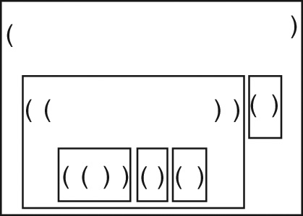
Non-Linear CFG: Example 7.11
Proper nesting language (parentheses matching)
The string must start with an a, that is, an opening parenthesis.
At any point, counting from left to right (i.e., in any prefix), the number of closing parentheses (i.e., b) encountered thus far cannot be greater than the number of opening parentheses (i.e., a).
The number of opening and closing parentheses must be equal at the end of the string.
S → aSb | SS | λ
Example: ((((())()()))()), that is, aaaaabbababbbabb
Tree structure:

Slide 14

Non-Linear CFG: Example 7.12
Equal numbers of a and b in any order (n_{a} = n_{b})
S → aSb | bSa | SS | λ
Example: babbabaaaababb
Derivation:
Count the difference:
(0)b(–1)a(0)b(–1)b(–2)a(–1)b(–2)a(–1)a(0)a(1)a(2)b(1)a(2)b(1)b(0)

Slide 15
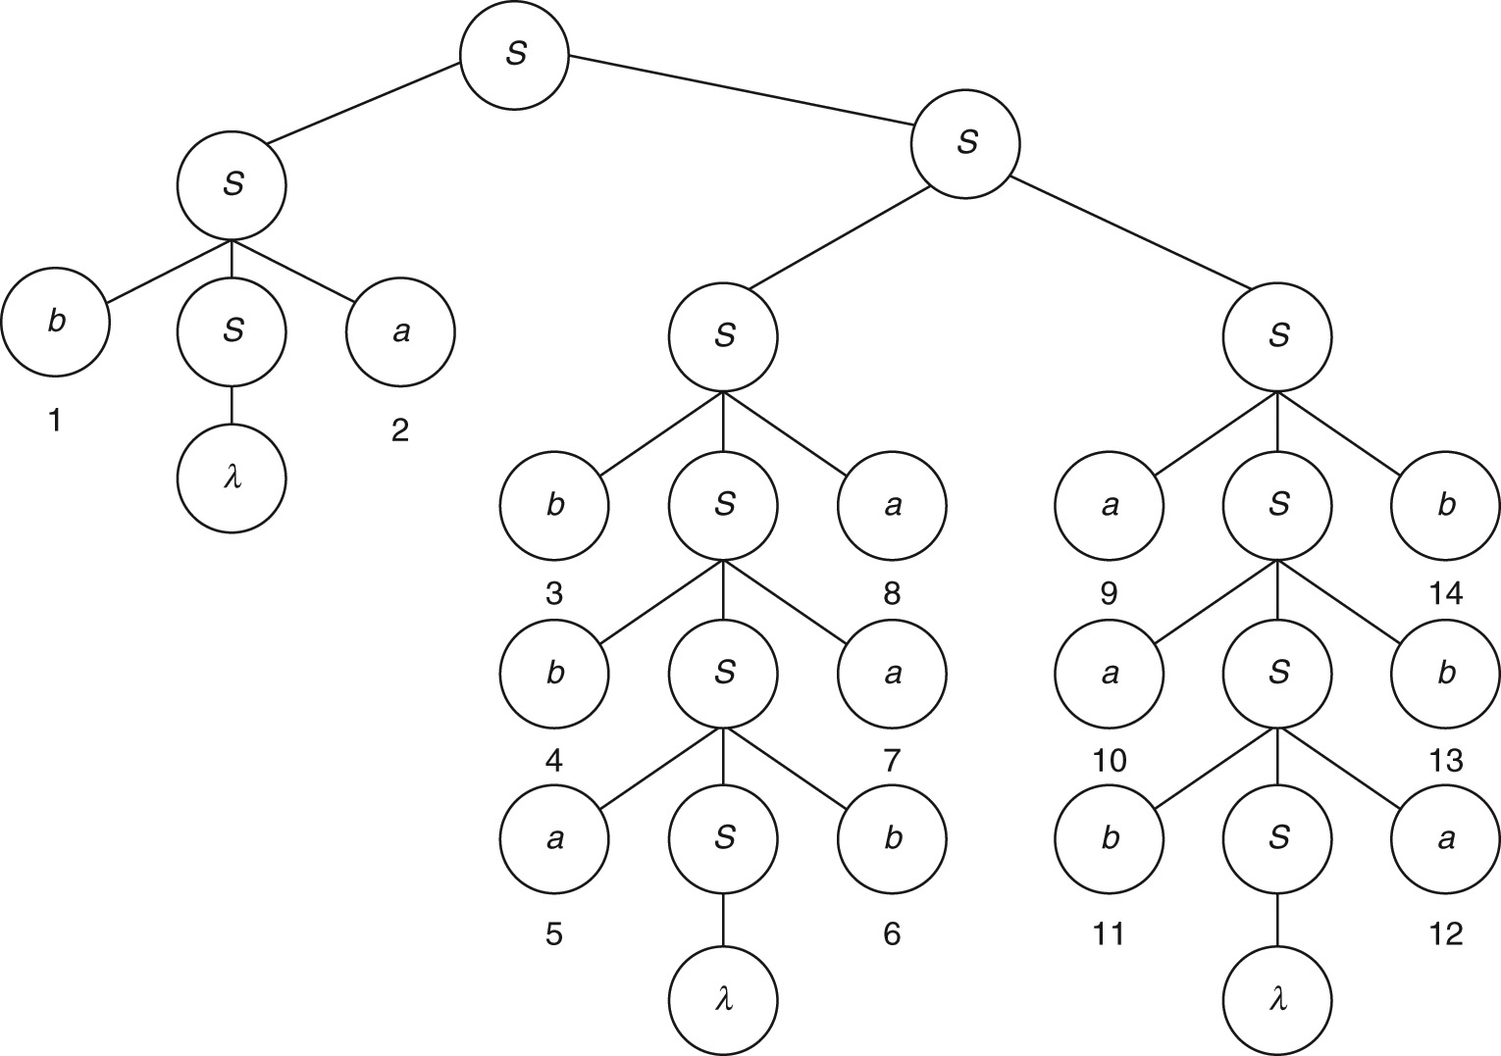
Parse Tree: Example 7.12

Slide 16
Non-Linear CFG: Example 7.13
Unequal numbers of a and b in any order
S → T | U
T → aTb | bTa | TT | a | aT | Ta
U → aUb | bUa | UU | b | bU| Ub

Slide 17
Non-Linear CFG: Nested If-Then-Else
Example 7.14:
Σ = {if, condition, then, else, statement, \{, \} }
An example string in the language is as follows:
If condition then statement else { if condition then statement else statement }
CFG:
S → if condition then S
S → if condition then S else S
S → { S }
S → statement

Slide 18

Non-Linear CFG: Arithmetic Expressions
Example 7.15: Σ = { variable, constant, +, -, *, /, (, ) }
S → S + S
S → S * S
S → S – S
S → S / S
S → (S)
S → variable | constant
Example: (x + 2.0) * y / (z – 6.0)
Derivation:

Slide 19
Mantras for CFGs
In addition to mantras for regular grammars (Chapter 5):
Since CFGs have the ability to generate strings with a tree structure, we need not be constrained by left-to-right processing of strings. Thinking in terms of parse trees and actually constructing parse trees for a few sample strings in the language will help in writing a suitable grammar.
As we will see in Chapter 9, CFLs have two parts in their strings that are correlated with one another. For example, the number of opening parentheses must match the number of closing parentheses. Figure out what is the correlation in the given language. To model such correlated behaviors, CFGs can add corresponding elements in two places in the string being generated by having non-regular productions (i.e., rules of the form S … S ... where the variable is in the middle of the right-hand side).
CFGs can also be non-linear, that is, they can have more than one variable on the right-hand side of a production rule. This gives them the ability to concatenate sub-strings (or join sub-trees) each of which can be from its own CFL. A single non-linear production of the form S SS is often sufficient. If you determine that the given language is non-linear, apply the counting technique used in Example 7.12 to mark the boundaries of the sub-strings to be concatenated. This will help in separating the linear and non-linear parts of the grammar.

Slide 20
Mantras for CFGs (contd..)
It is often useful to compare the given language to one of the known CFLs such as the languages of simple nesting, proper nesting, addition, if-then-else and arithmetic expressions. Differences, if any, can be accommodated by modifying the production rules appropriately.
CFLs usually have some parts that are regular as well, that is, in addition to their correlated context-free behaviors, strings in the language contain parts that can be modeled using regular expressions. For example, one or more extra symbols (i.e., a^{n}b^{n + 1}), some symbols in the middle (i.e., odd palindromes) and so on. Figuring out these will ease the construction of suitable productions (which by themselves tend to be right or left-linear) for modeling the regular parts of the language.

Slide 21
Parsing: Simple Algorithm
Algorithm
Start with just the variable S as the initial sentential form;
Find a production whose left-hand side matches one of the variables in the sentential form
Replace the variable by the right-hand side of the production;
If the resulting sentential form does not match the given string,
try a different production.
Until the given string is derived completely.

Slide 22

Ambiguity: Example 7.12 (again)
Equal numbers of a and b in any order (n_{a} = n_{b})
S → aSb | bSa | SS | λ
Example: babbabaaaababb
Derivation:
Another derivation:

Slide 23
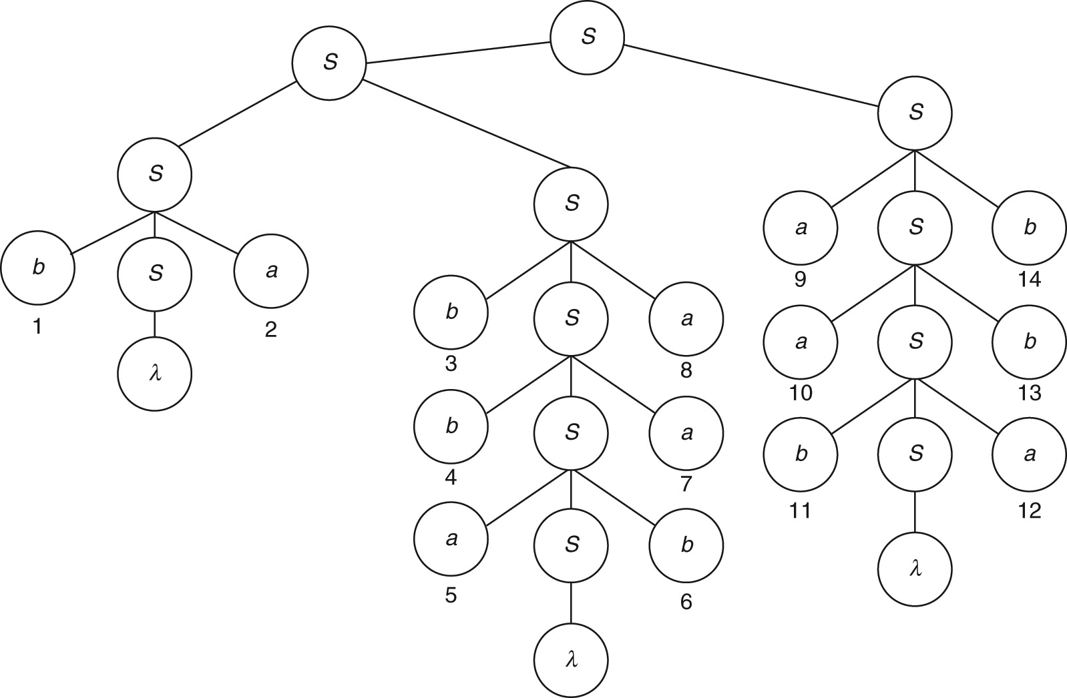
Ambiguity: Two Parse Trees

Slide 24
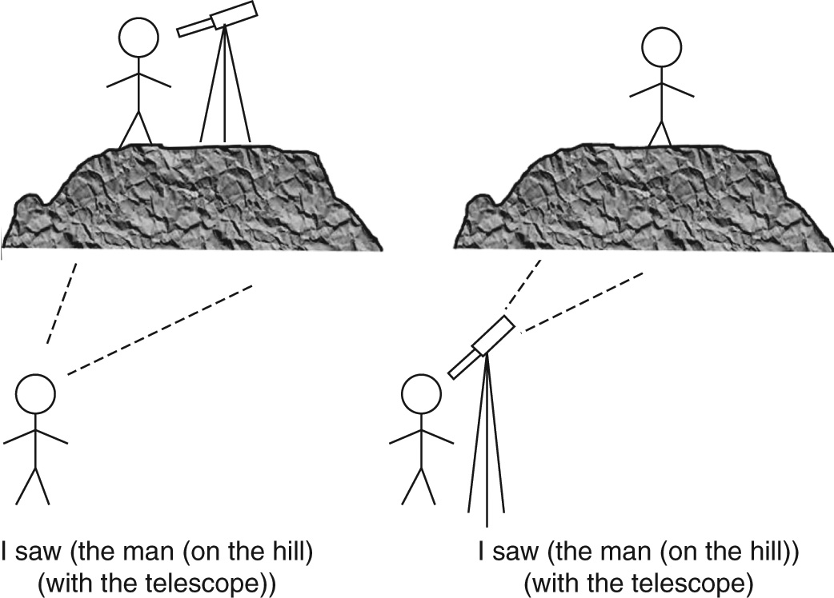
Ambiguity in Natural Language
I saw the man on the hill with the telescope.

Slide 25

Ambiguity in Expression Evaluation
Example 7.15: Σ = { variable, constant, +, -, *, /, (, ) }
S → S + S
S → S * S
S → S – S
S → S / S
S → (S)
S → variable | constant
Example 7.16: a + b/c with two leftmost derivations;

Slide 26
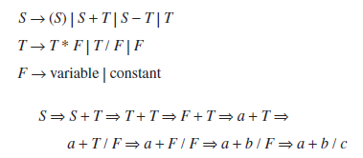
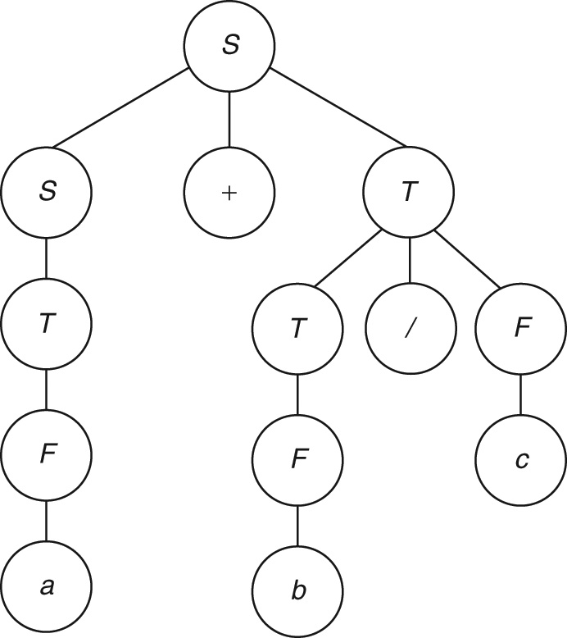
Eliminating Ambiguity: Example 7.17
Modified expression grammar
Grammar
Single leftmost derivation

Slide 27
The Idea of Chomsky Normal Form
Normal forms clean up a grammar
They make parsing efficient
Any CFG can be converted to Chomsky Normal Form
If the language includes the null string, it should be excluded
Chomsky Normal Form: every production is of one of the two forms:
A → a Replaces a variable in the sentential form by a terminal symbol
A → BC Replaces a variable by two variables to grow the sentential form
Idea: Binary parse tree
Idea: Each step in derivation either does not change the length of the sentential form or grows it by 1

Slide 28
Cleaning up a Grammar
Grammars in normal forms cannot have
Lambda productions of the form A → λ. Variables having such productions are called nullable variables.
Unit productions of the form A → B which merely replace one variable by another without making any progress in the derivation.
Useless variables which are of two kinds:
Non-generating ones which never lead to terminal symbols. If a non-generating variable is introduced into the sentential form, it is a dead-end; the sentential form can never generate any string in the language since there is no way to get rid of the non-generating variable.
Productions for unreachable variables. An unreachable variable, on the other hand, does not appear on the right-hand side of any production (to make it reachable from the start symbol S) and hence will never appear in a sentential form.

Slide 29
Converting to Chomsky Normal Form
Algorithm
Eliminate lambda productions: If there is a lambda production A  λ, delete the production after changing all other productions where A occurs on the right-hand side as follows:
In a production B  xAy, remove the nullable A by replacing it with:
B xy | xAy If there is some other production that expands A or just
B xy If there is no other production for A
Eliminate unit productions: For every unit production A  B, delete the production by replacing any occurrence of A with B on the right-hand sides of all other productions, that is, replace
C  xAy by C  xAy | xby
(or just C  xBy if there is no other production for A).
3. Eliminate useless variables: Simply delete all productions containing unreachable and non-generating variables. A variable is useful if it is a part of the derivation of at least one string in the language of the grammar; useless ones are those do not take part in any derivation as a result of one of two things: (a) they are unreachable from S (i.e., S cannot derive the variable in any sentential form) or they are non-generating (i.e., they cannot get rid of themselves to introduce only terminal symbols).

Slide 30
Converting to CNF (contd..)
Re-write productions in CNF form as follows:
Productions which are already of the form A  a or A  BC are fine;
If a production A  BCD has more than two symbols on the right-hand side,
introduce new, intermediate variables and productions of the form:
A  BE and E  CD
If a production A bC has a terminal and a non-terminal,
re-write it in the form:
A  BC and B  b both of which are in CNF.

Slide 31
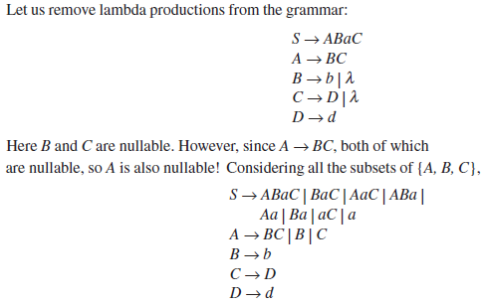
Removing Lambda Productions: Example 7.18
Let us remove lambda production from the grammar:
Here B and C are nullable. However, Since A BC, both of which are nullable, so A is also nullable! Considering all the subsets of {A, B, C},

Slide 32
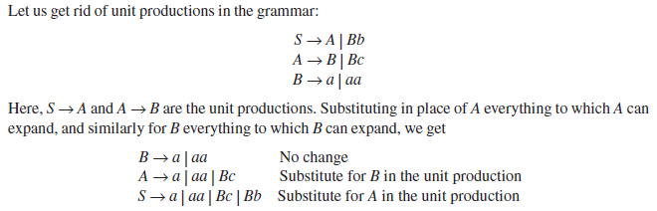
Removing Unit Productions: Example 7.19
Let us get rid of unit productions in the grammar:
Here, S  A and A  B are the unit productions. Substituting in place of A everything to which A can expand, and similarly for B everything to which B can expand, we get

Slide 33
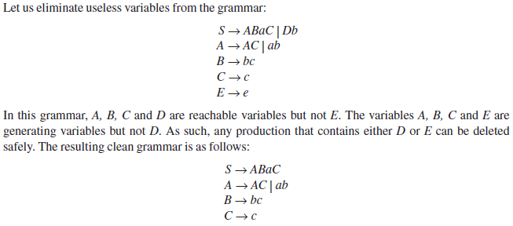
Removing Useless Variables: Example 7.20
Let us eliminate useless variables from the grammar:
In this grammar, A, B, C and D are reachable variables but not E. The variables A, B, C and E are generating variables but not D. As such, any production that contains either D or E can be deleted safely. The resulting clean grammar is as follows:

Slide 34
Order of Steps in Converting to CNF
Eliminate lambda productions
Eliminate unit productions
Eliminate useless variables
Rewrite in Chomsky Normal Form
Remember: lambda units are useless

Slide 35
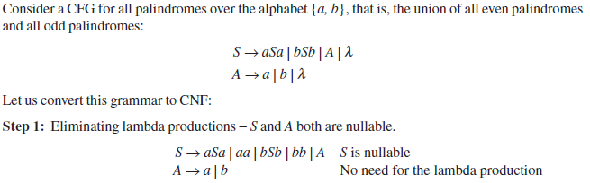
Converting to CNF: Example 7.21
Consider a CFG for all palindromes over the alphabet {a, b}, that is, the union of all even palindromes and all odd palindromes:
Let us convert this grammar to CNF:
Step 1: Eliminating lambda productions-S and A both are nullable.

Slide 36
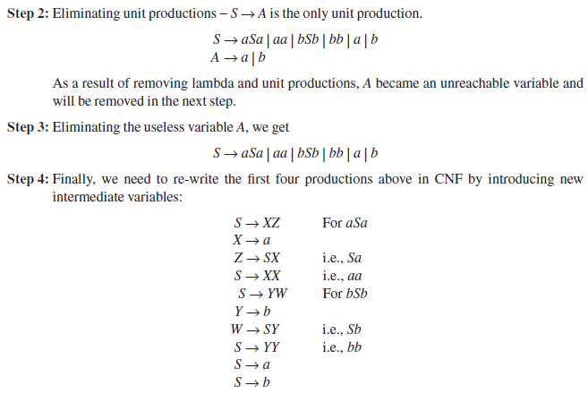
CNF: Example 7.21 (contd..)
Step 2: Eliminating unit productions-S  A is the only unit production.
As a result of removing lambda and unit productions, A became an unreachable variable and will be removed in the next step.
Step 3: Eliminating the useless variable A, we get
Step 4: Finally, we need to re-write the first four productions above in CNF by introducing new intermediate variables:

Slide 37
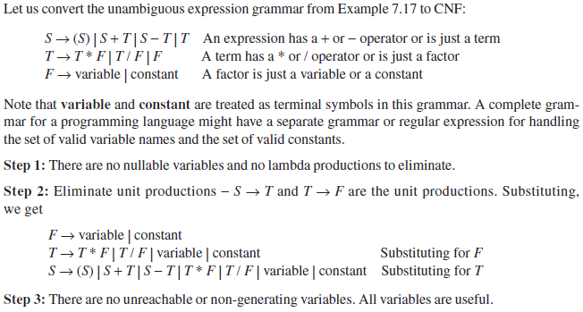
Converting to CNF: Example 7.22
Let us convert the unambiguous expression grammar from Example 7.17 to CNF:
An Expression has a + or – operator or is just a team
A term has a * or/operator or is just a factor
A factor is just a variable or a constant
Note that variable and constant are treated as terminal symbols in this grammar. A complete grammar for a programming language might have a separate grammar or regular expression for handling the set of valid variable names and the set of valid constants.
Step 1: There are no nulllable variables and no lambda productions to eliminate.
Step 2: Eliminate unit productions – S  T and T F are the unit productions, Substituting, we get
Step 3: There are no unreachable or non-generating variables. All variables are useful.

Slide 38
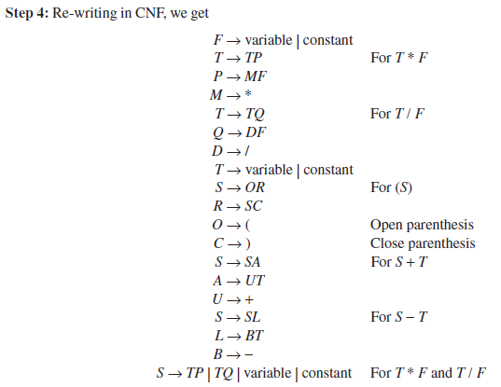
CNF: Example 7.22 (contd..)

Slide 39
Parsing with CNF: CYK Algorithm
Algorithm
For each individual symbol w [ i ] in the given string w,
List all the variables A which have a production A w [ i ]
For length I-2 to length n of the given string,
For each substring w [i..j] of length I,
List all the variables A which have a production A  BC
where for some k between i and j,
B is already enumerated for the substring w [i..k] and
C is already enumerated for the substring w [k+I..j]
If S is enumerated for the entire string w [ I..n], accept the string w; else, reject the string w,

Slide 40
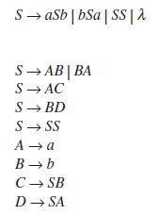
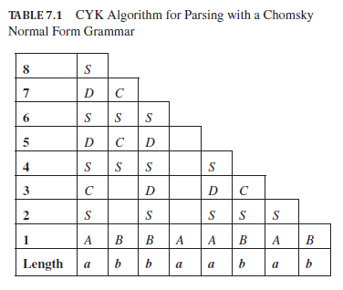
CYK Parsing: Example 7.23
Grammar:
CNF grammar:
Input string: abbaabab

Slide 41
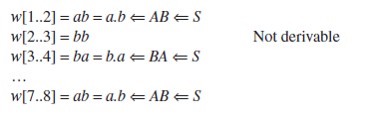
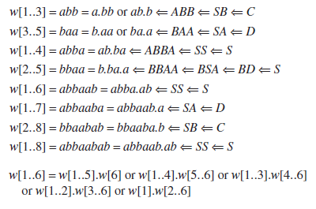
Filling CYK Table: Example 7.23 (contd..)

Slide 42
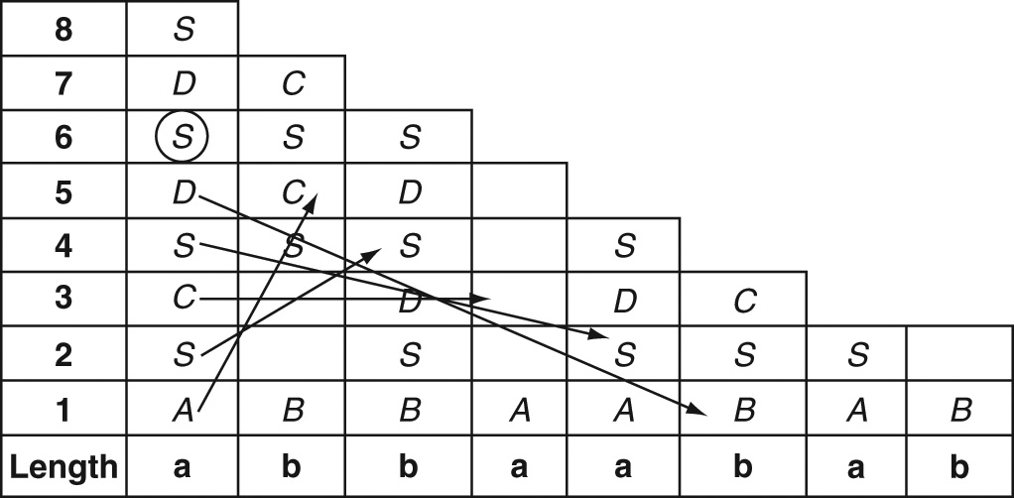
CYK Table-Filling: Pattern

Slide 43
The Idea of Greibach Normal Form
The idea of GNF is to make parsing linear, that is, every step in the derivation should introduce (or parse) exactly one terminal symbol from the input string.
With a grammar in GNF and a leftmost derivation, in each step, one more symbol, from left to right, is generated so that exactly n steps later, a string of length n is derived.
Every production in GNF looks like either of the following:
A → aBCD…
A → a
The leftmost symbol on the right-hand side of every production is a terminal symbol.
There cannot be any further terminal symbols in the production.
Instead, there can be zero or more non-terminals to the right of the terminal symbol.

Slide 44
Converting to GNF: Example 7.24
Equal numbers of a and b
S → aSb | bSa | SS | λ
Converting to GNF, we get:
S → aSB | bSA Introducing variables A for a and B for b
A → a
B → b
S → aSBS | bSAS Substituting for the first S from the above rules

Slide 45
Simple Grammars
All regular grammars are of course linear.
A good characteristic of linear grammars is that, since there is only one variable on the right-hand side of any production, the sentential form always contains just one variable (except when the entire string is generated and there are no variables). The parser needs to consider only productions for that one variable. This reduces the number of choices for the parser, thereby making parsing more efficient.
In general, inefficiency in parsing is caused by the number of production rules that can be applied to the present sentential form.
Even in a linear grammar, there are still multiple choices since there can be more than one production with the same variable on the left-hand side.
An effective way to reduce the number of choices is to ensure that each production rule being applied matches the “next” terminal symbol in the input string to be generated or parsed.
For example, GNF ensured that every production began with a terminal symbol. A production can be applied in parsing with GNF only if its terminal symbol matches the next symbol in the input string.

Slide 46
Simple Grammars (contd..)
For example, if the current sentential form is aaSBB and the complete input string is aabbaab and the available productions for S are as follows:
S → aSB Next input symbol must be a: NOT APPLICABLE
S → bSA Next input symbol must be b: APPLICABLE
In GNF, there can still be more than one production rule that matches a given sentential form (even in a leftmost derivation).
This choice is eliminated in a stricter type of grammar known as simple grammar or s-grammar in which, for a given variable T and given terminal symbol a, there can be only one production rule of the type T aXYZ.
There is also a sub-class of CFGs known as deterministic context-free grammars (see Chapter 11, Sec. 11.12).

Slide 47
Theorems
Theorem 11: Substitution rule for Grammars: If a grammar has a set of productions:
A uBv and B x | y | z
where u, v, x, y, z stand for any piece of a sentential form with terminal and non-terminal symbols, then the grammar obtained by eliminating the B productions by substituting the right-hand sides of those productions wherever B occurs in other productions is equivalent to the original grammar:
A uxv | uyv | uzv
Theorem 12: Equivalence of cleaned-up grammars: The grammar obtained by eliminating λ-productions, unit productions and useless variables from a context-free grammar is equivalent to the original grammar.
Theorem 13: Chomsky Normal Form: Every context-free grammar whose language does not contain λ can be converted to an equivalent grammar that is in Chomsky Normal Form.
Theorem 14: Greibach Normal Form: Every context-free grammar whose language does not contain λ can be converted to an equivalent grammar that is in Greibach Normal Form.

Slide 48
Key Ideas
Context-free behavior arises when an action is taken irrespective of the surrounding context. A context-free language is one in which the occurrence or behavior of a symbol or pattern in a string is independent of other symbols or patterns to its left or right.
A context-free language is the language of a context-free grammar.
A context-free grammar is one in which every production rule has a single non-terminal and no other symbol on its left-hand side.
A production in a context-free grammar can be applied during parsing or derivation to a non-terminal in the sentential form without regard to other symbols in the sentential form.

Slide 49
Key Ideas (contd..)
Context-free grammars are more powerful than regular grammars. They can derive languages that are not regular.
A linear context-free grammar has only zero or one non-terminal on the right-hand side of every production rule. However, such a grammar may not be right-linear or left-linear. Non-regular linear grammars can derive languages such as palindromes and the simple nesting language.
Other context-free languages require non-linear grammars with production rules that have more than one non-terminal on their right-hand sides. The typical pattern SS is used to generate languages such as proper nesting, nested if-then-else statements and arithmetic expressions in programming languages.
A context-free grammar is said to be ambiguous if it produces two different leftmost (or two different rightmost) derivations for the same string.
Often, an ambiguous grammar can be converted to an unambiguous grammar by introducing additional variables.
A language is said to be inherently ambiguous if every grammar for the language is ambiguous.

Slide 50
Key Ideas (contd..)
Grammars can be cleaned up by eliminating λ-productions, unit productions and useless (i.e., non-generating or unreachable) variables.
A context-free grammar can be converted to Chomsky Normal Form in which every production is in one of two forms: A a or A BC. The idea is to ensure that the application of a production during derivation either eliminates a non-terminal by replacing it by a terminal symbol or grows the sentential form by exactly one symbol. This results in a binary parse tree.
The CYK algorithm can be applied to a grammar in Chomsky Normal Form to determine if a given string is grammatical, that is, belongs to the language of the grammar. Book-keeping in the CYK algorithm is made easy by applying a table-filling technique.

Slide 51
Key Ideas (contd..)
The idea of a Greibach Normal Form is to ensure that every step in parsing consumes exactly one terminal symbol. Productions in this form have exactly one terminal symbol followed by zero or more non-terminals on their right-hand sides.
Simple grammars and other variations are used to reduce ambiguity and make parsing more efficient. Such context-free grammars are used extensively in the design of programming languages and compilers.
Although there is no algorithm to design a context-free grammar, the set of mantras discussed in the chapter help us in designing an accurate grammar for a given problem.

Slide 52
End of Chapter 7

